Slide 1
Git and GitHub
Penn State IEEE FA21
Led by Will McGloughlin

Slide 2
Make a GitHub account!
You’ll need it for the interactive portion

Slide 3
Why use version control?
Notes:
Have a log of changes
Can revert back to a point in time if something breaks
Can help organize code collaboration

Slide 4
Why use version control?
Log changes in a codebase
Revert back to working code
Organize collaboration
Notes:
Have a log of changes
Can revert back to a point in time if something breaks
Can help organize code collaboration

Slide 5
What is Git?

Slide 6

What is Git?
Created by Linus Torvalds in 2005 for Linux kernel development
The most popular VCS today
Command line tool you’ll use for most online services (ie. GitHub, GitLab, etc.)
Notes:
Have a log of changes
Can revert back to a point in time if something breaks
Can help organize code collaboration

Slide 7
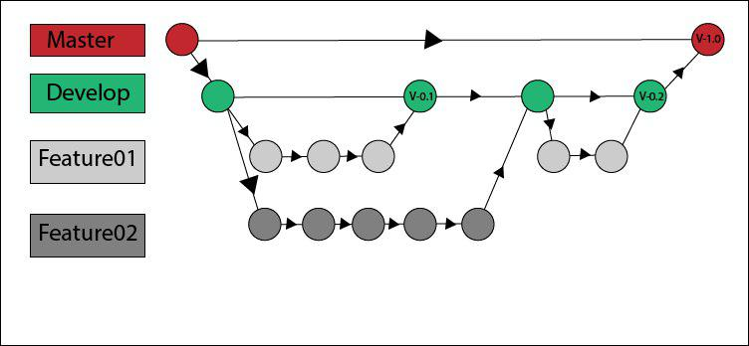
Key terms
Repository
Codebase of a project
Ex. projects2021, chrislgarry/Apollo-11, pokered
Commits
Take a snapshot of your work at a point in time
Commit messages to label the snapshots
Branches
Copies of a base branch
Work on features independently of the rest of the project

Slide 8
Key terms
Push
Upload your staged commits to the web
Pull
Download any updates from the parent branch
Fork
Copy an entire repository to your account
Pull Request (PR)
Ask the project maintainer to add changes from a branch/fork to another branch

Slide 9
How do we get Git?
Pre-installed on Macs and most Linux distros
Check with command line: git --version
“git version #.#.#”
Windows
Surprise! Going to have to install something
https://git-scm.com/download/win
Check with command line: git --version
“git version #.#.#.windows.#”

Slide 11
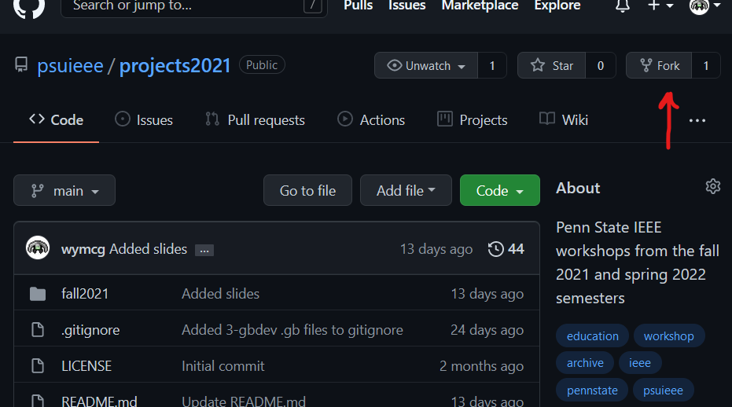

Slide 12
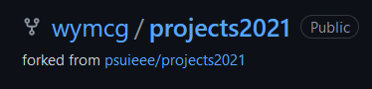

Slide 13
Getting around
in your terminal

Slide 15
Uh, so now what?
Now you have a fork of the projects2021 repo on your PC!
Why aren’t you cheering?
Make changes to projects2021/fall2021/2-git/CHANGEME.txt
Keep it PG-13 and one line, please
Remember that these changes are all public
Once everyone has made a change, we will move on

Slide 16
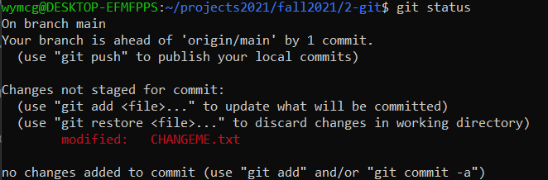

Slide 17
OR

Slide 18
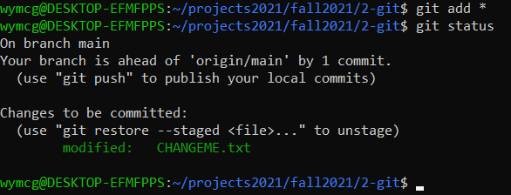

Slide 19
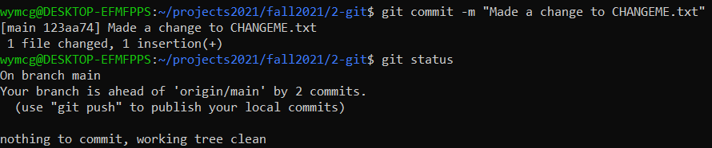

Slide 20
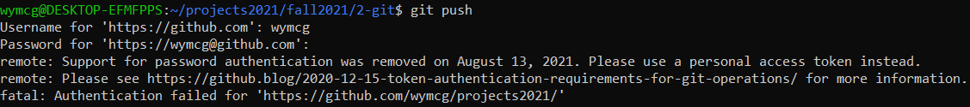
Now, let’s push!
oh

Slide 21
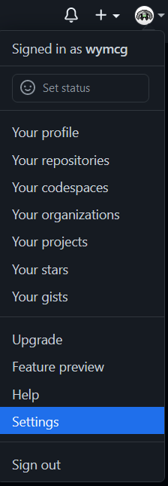
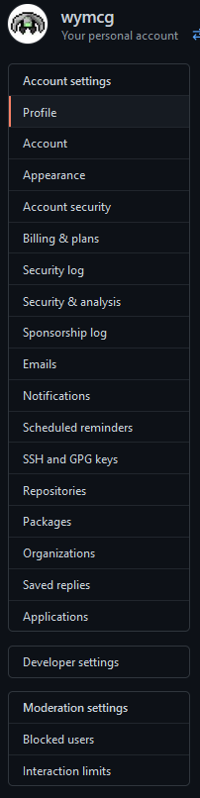
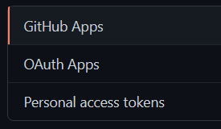


Slide 22

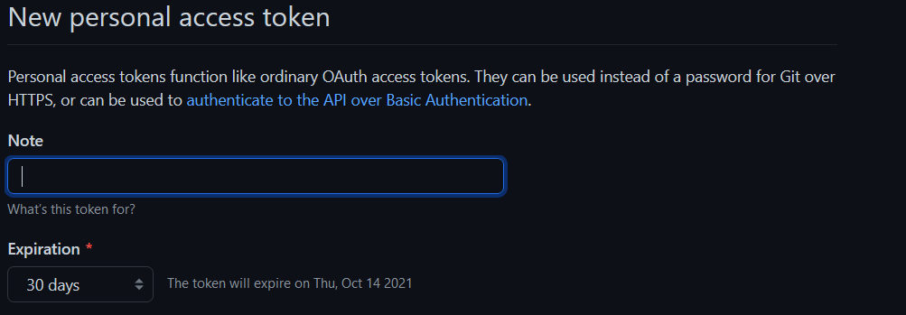

Slide 23
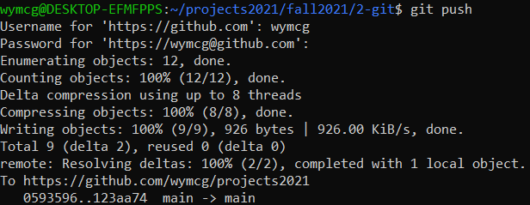

Slide 24
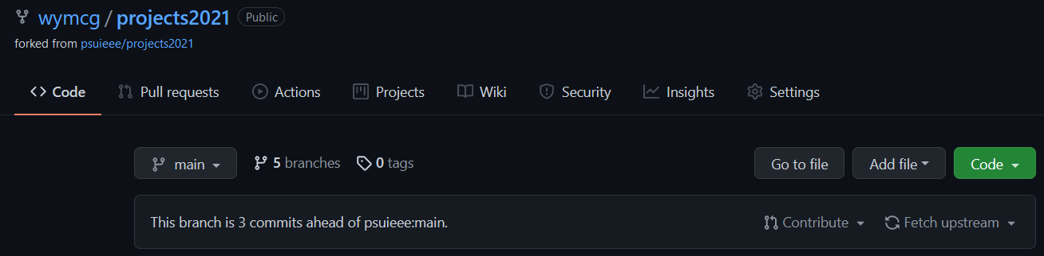

Slide 25
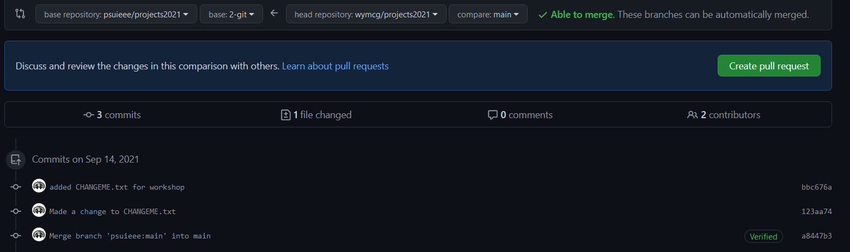

Slide 26
